Slide 1
Virtualization Unit-III
Prof. Vaishali Thakur

Slide 2
Virtualization in cloud
Cloud providers use virtualization to pool physical resources (like CPU, memory, and storage) and allocate them dynamically to users as needed. This allows cloud services to scale up or down based on demand without requiring additional physical infrastructure. For example, when you request more resources for a virtual machine (VM) or container, the cloud provider allocates additional virtualized resources from its pool.

Slide 3
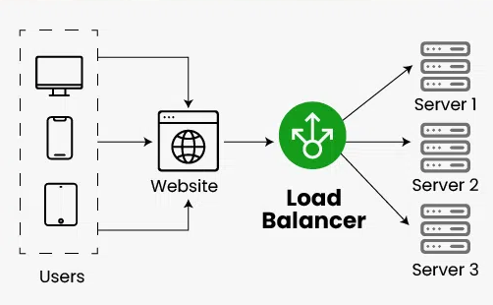
Load Balancers
Load Balancer is defined as a networking device or software application that distributes and balances the incoming traffic among the servers to provide high availability, efficient utilization of servers, and high performance.

Slide 4
Why Load Balancing Is Important
Improved Performance: By distributing the load, no single server gets overwhelmed, and users experience faster response times.
High Availability: In case one server fails, the load balancer can redirect traffic to healthy servers, minimizing downtime.
Scalability: Load balancing helps to scale out services horizontally by adding more servers or containers to handle increased traffic.

Slide 5
Types of Load Balancing
Layer 4 Load Balancing (Transport Layer)
Works on Layer 4 of the OSI model (TCP/UDP), meaning it makes routing decisions based on IP addresses and ports.
It operates at the transport layer and forwards the traffic without inspecting the content.
Ideal for applications where the network layer or transport layer decisions are enough to distribute traffic, like HTTP or FTP requests.
Layer 7 Load Balancing (Application Layer)
Works on Layer 7 of the OSI model (Application Layer), which means it makes routing decisions based on the content of the request (such as HTTP headers, cookies, URL paths, etc.).
Provides more advanced routing, such as content-based routing or directing traffic based on user sessions.
Common in web applications where requests might need to be directed to specific servers based on things like URL paths or user sessions.

Slide 6
How Load Balancing Works
Client Requests: A client makes a request to access a service, typically through a URL or IP address.
DNS or Direct Routing: The client is routed to a load balancer, either via DNS resolution or directly to an IP address.
Load Balancer Decision: The load balancer decides where to route the request based on the algorithm being used.
Routing: The load balancer forwards the request to one of the backend servers or services.
Server Response: The backend server processes the request and sends a response to the load balancer, which forwards it back to the client.

Slide 7
Load Balancer Types
Hardware Load Balancer
Physical devices dedicated to load balancing.
Examples: F5 BIG-IP, Cisco, Citrix NetScaler.
Suitable for large enterprises with high traffic, but less flexible and scalable than software-based solutions.
Software Load Balancer
A software application or tool that runs on standard hardware.
Examples: NGINX, HAProxy, Traefik.
More flexible and scalable than hardware load balancers. They are also commonly used in cloud-native environments.
Cloud Load Balancer
Load balancers offered by cloud service providers as part of their infrastructure services.
Examples: AWS Elastic Load Balancing (ELB), Google Cloud Load Balancing, Azure Load Balancer.
These are fully managed solutions that are tightly integrated into the cloud environment and offer scalability and high availability.

Slide 8
Load Balancing Algorithms
Static Load Balancing Algorithms
Round Robin Load Balancing Algorithm
Weighted Round Robin Load Balancing Algorithm
Source IP Hash Load Balancing Algorithm
Dynamic Load Balancing Algorithms
Least Connection Method Load Balancing Algorithm
Least Response Time Method Load Balancing Algorithm

Slide 9
Round Robin:
Requests are distributed in a sequential, circular manner across the servers. Once all servers are used, the load balancer starts again from the first server.
Best for: Equal load distribution across servers.
Weighted Round Robin:
Similar to Round Robin but with an added weight to servers. Servers with higher weights get more requests.
Best for: Systems where certain servers are more powerful or can handle more traffic.
IP Hash:
A hash of the client’s IP address determines which server will handle the request. This ensures that a client’s requests are directed to the same server.
Best for: Session persistence, where you want to keep the same client connected to the same server.

Slide 10
Least Connections:
The load balancer directs traffic to the server with the fewest active connections.
Best for: Servers with varying workloads, where some requests may take longer than others.
Least Response Time:
Routes traffic to the server that responds the fastest to requests.
Best for: Applications where response time is crucial, such as real-time applications.

Slide 11
Containers
Containers are a lightweight, portable, and self-sufficient unit for deploying software applications. They allow developers to package an application and its dependencies (such as libraries, configurations, and system tools) into a single object. The goal of containers is to enable consistent environments across different stages of development, testing, and production, regardless of the underlying infrastructure.

Slide 12
Main Benefits
Portability: Since containers encapsulate everything the application needs, they can run consistently across different platforms and environments (such as developer machines, testing servers, or cloud environments).
Isolation: Containers run in isolated environments, meaning that the software inside a container won't interfere with other software running on the host system. This isolation also helps in managing dependencies more efficiently.
Efficiency: Containers are much lighter compared to traditional virtual machines (VMs) because they share the host system's OS kernel instead of requiring a full OS for each application instance. This results in faster start-up times and lower resource consumption.

Slide 13
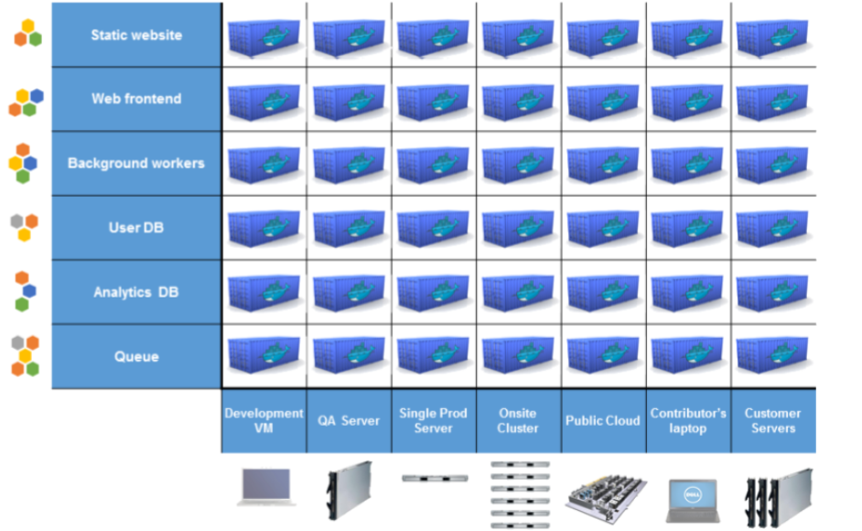
Containers

Slide 14
Container security
Container security is the practice of securing Container application and infrastructure against security risks. The goal of container security is to detect, assess, and remediate misconfigurations, software vulnerabilities, and other issues that threat actors could exploit to take control of containers themselves or the systems on which they run.
Note : Container security is similar to application security in general. It includes some of the same practices, such as scanning for vulnerabilities.

Slide 15
Docker
Docker is one of the most popular tools for working with containers. It simplifies the process of creating, deploying, and managing containers by providing a consistent and user-friendly interface. Docker automates much of the containerization process, making it easier for developers to focus on building and running applications instead of managing the underlying infrastructure.

Slide 16
Key components of Docker
Docker Engine: The core component of Docker that runs and manages containers. It has two primary parts:
Docker Daemon: A background process that manages Docker containers and images.
Docker CLI (Command-Line Interface): A user interface that allows interaction with the Docker daemon to run commands like creating, running, and managing containers.
Docker Images: These are the blueprints from which containers are created. An image is a lightweight, stand-alone, executable package that includes everything needed to run a piece of software, such as code, libraries, and dependencies.
Docker Containers: A running instance of a Docker image. When you run a Docker container, the image becomes an active instance that runs your application. Containers are isolated from one another but share the underlying host OS kernel.

Slide 17
Docker Hub: A cloud-based repository where Docker images are stored and shared. Docker Hub allows users to share their images with others or download pre-built images for various applications (such as databases, web servers, etc.).
Dockerfile: A text file that contains a set of instructions for building a Docker image. It defines the environment in which the application will run, including the base image, application code, dependencies, and environment variables.
Docker Compose: A tool used to define and run multi-container Docker applications. With Docker Compose, you can define multiple containers and how they interact within a single YAML file, making it easier to manage complex applications.

Slide 18
Containers vs VMs
Feature | Containers | Virtual Machines (VMs)
Architecture | Shares host OS kernel, uses isolated processes. | Includes a full guest OS and virtualized hardware.
Startup Time | Fast (seconds). | Slow (minutes).
Resource Usage | Efficient (isolates processes, shares OS kernel). | High (each VM requires its own OS and kernel).
Isolation | Process-level isolation using namespaces and cgroups. | Strong isolation with full OS-level separation.
Size | Small (megabytes, lightweight). | Large (gigabytes, includes OS).
Portability | Highly portable (runs the same on any environment with the container runtime). | Less portable (needs hypervisor support and VM image compatibility).
Boot Time | Immediate. | Takes time to boot the entire OS.
Use Cases | Microservices, lightweight applications, DevOps. | Full-scale applications, legacy apps, isolated environments.

Slide 19
How process isolation in containers: Namespaces
Isolation in containers is primarily achieved through namespaces, a key feature in the Linux kernel that allows containers to have separate views of system resources, effectively isolating their processes from the host and other containers. Here’s how each namespace contributes to container isolation:
Example:
Process A in Container 1 has PID 1.
Process B in Container 2 also has PID 1.
They don’t interfere with each other due to PID namespaces.

Slide 20
Types of Namespaces
PID (Process ID) Namespace:
Isolates the process ID number space.
Containers see only their own processes.
NET (Network) Namespace:
Isolates network interfaces.
Each container has its own virtual network stack.
MNT (Mount) Namespace:
Isolates the file system mount points.
Containers see only their own file system.

Slide 21
From Docker to Kubernetes
While containers are great for packaging applications, managing them at scale (e.g., hundreds or thousands of containers) across multiple hosts becomes complex. You need to manage things like:
Scaling: How many containers to run based on traffic
Load balancing: Distributing requests across containers
Health checks: Ensuring containers are running correctly
Networking: Connecting containers , both internally and to the external world
Storage: Persisting data beyond the lifespan of a container

Slide 22
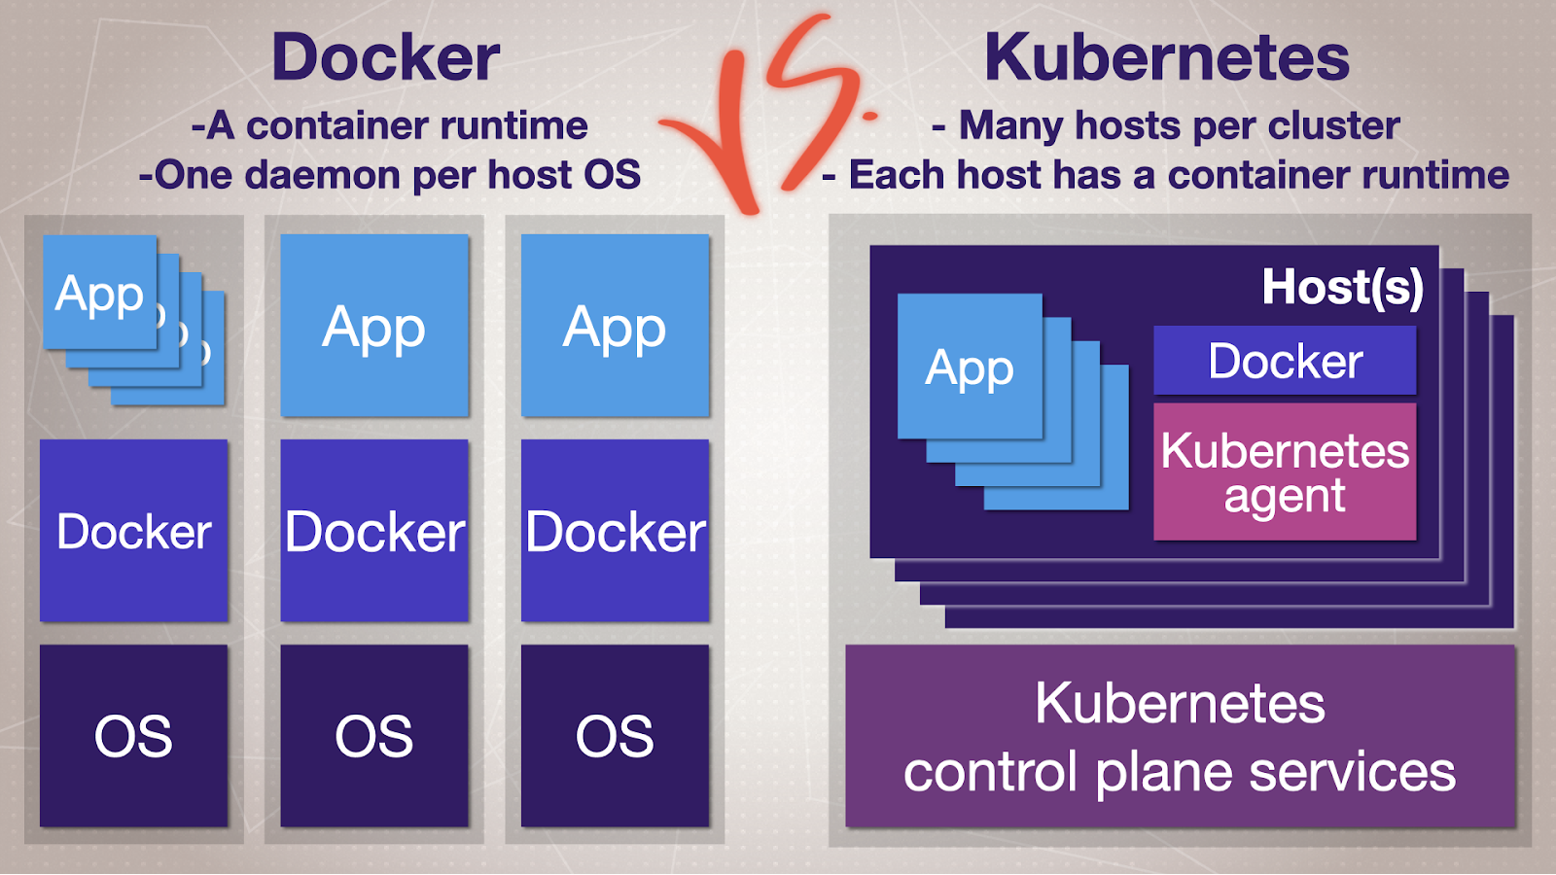

Slide 23
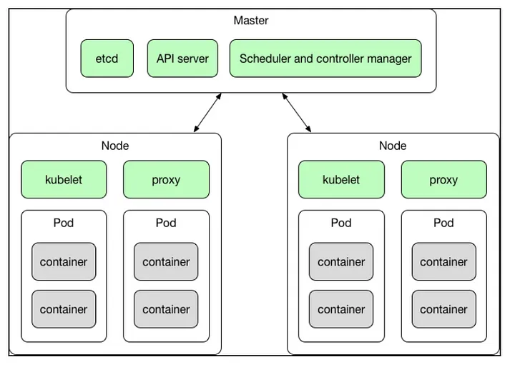
Kubernetes

Slide 24
Kubernetes Architecture
Master Node Components:
Responsible for controlling the cluster and making decisions regarding the scheduling and execution of containers.
API Server: The API server acts as the front-end for the Kubernetes control plane. It processes all RESTful API calls (e.g., from kubectl commands) and is the central point for all interactions in the cluster.
Scheduler: The scheduler is responsible for assigning containers (pods) to specific worker nodes based on resource availability and requirements. It ensures the optimal placement of containers in the cluster.
Controller Manager: The controller manager oversees the state of the cluster, ensuring that the system's desired state matches the current state. It manages replication, node health, and endpoint assignments.
etcd: Etcd is a distributed key-value store that Kubernetes uses to store all cluster data, including configurations, resource states, and other metadata.

Slide 25
Kuburnetes
Worker Node Components:
Worker nodes are where the actual containers run. Each worker node contains several components that communicate with the master and run containerized applications.
Kubelet: The kubelet is an agent running on every worker node, which ensures that containers are running as expected. It listens to the instructions from the API server and manages the state of the node.
Container Runtime: This is the software responsible for running containers on a worker node. Kubernetes supports various container runtimes like Docker, containerd, and CRI-O.
Kube-Proxy: Kube-proxy is a network proxy running on each worker node. It maintains network rules that allow communication to and from the containers, providing service discovery and load balancing within the cluster.

Slide 26
POD
A pod is the smallest, most basic deployable unit in Kubernetes. It represents a single instance of a running process in your cluster.
Features
Encapsulates Containers:
A pod can contain one or more containers (usually just one).
Tightly Coupled Applications: Pods group together tightly coupled containers that need to share resources.
For example, a web server and a logging sidecar container may run in the same pod.
Unique IP Address:
Each pod gets its own unique IP address within the cluster, making communication straightforward without worrying about container-specific networking.

